Slide 1
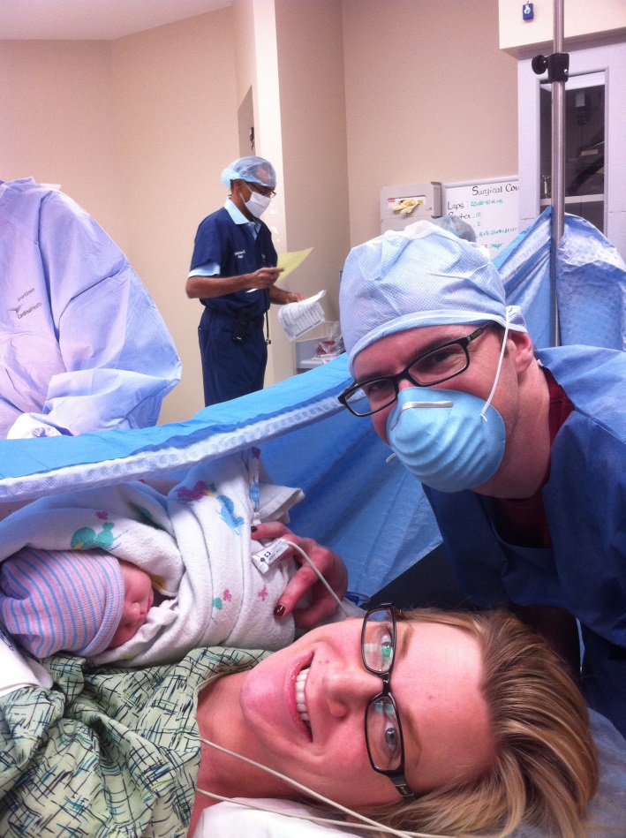
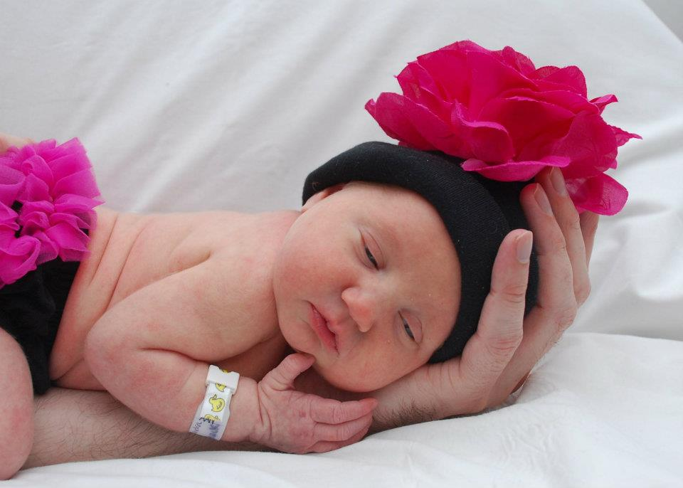
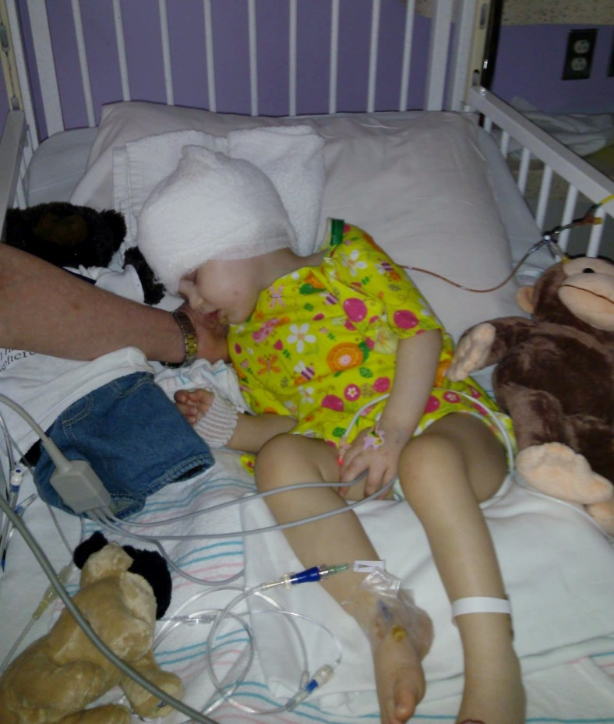
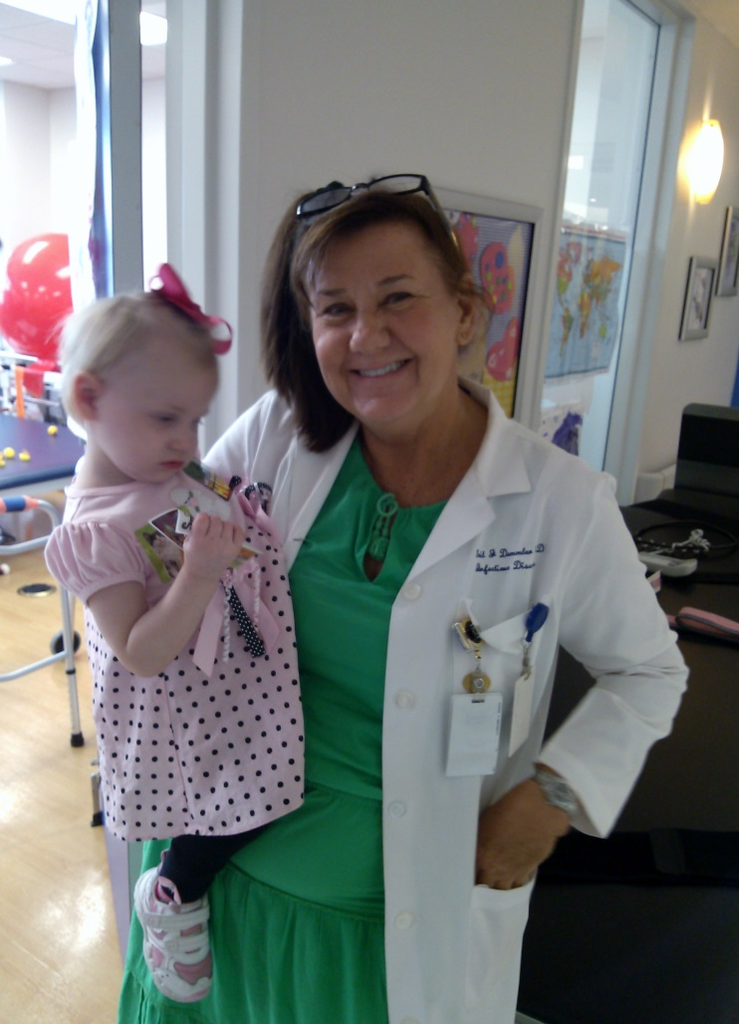
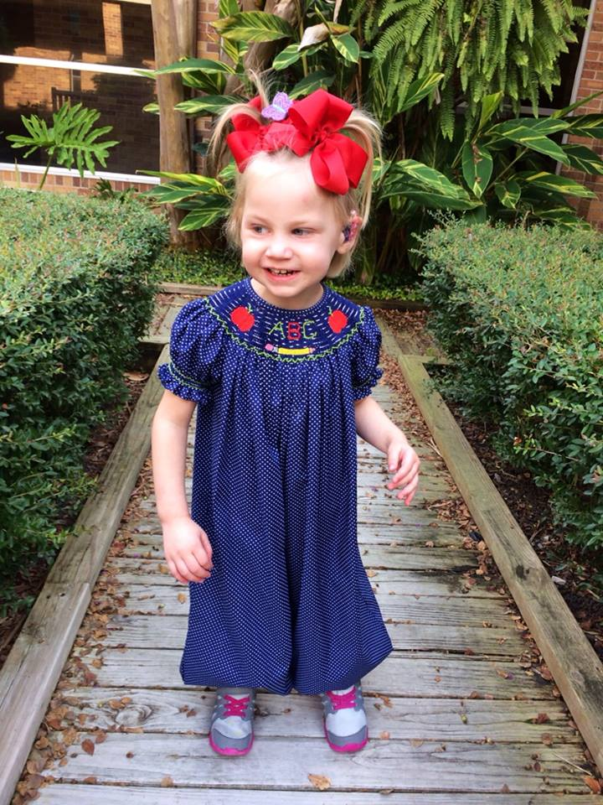
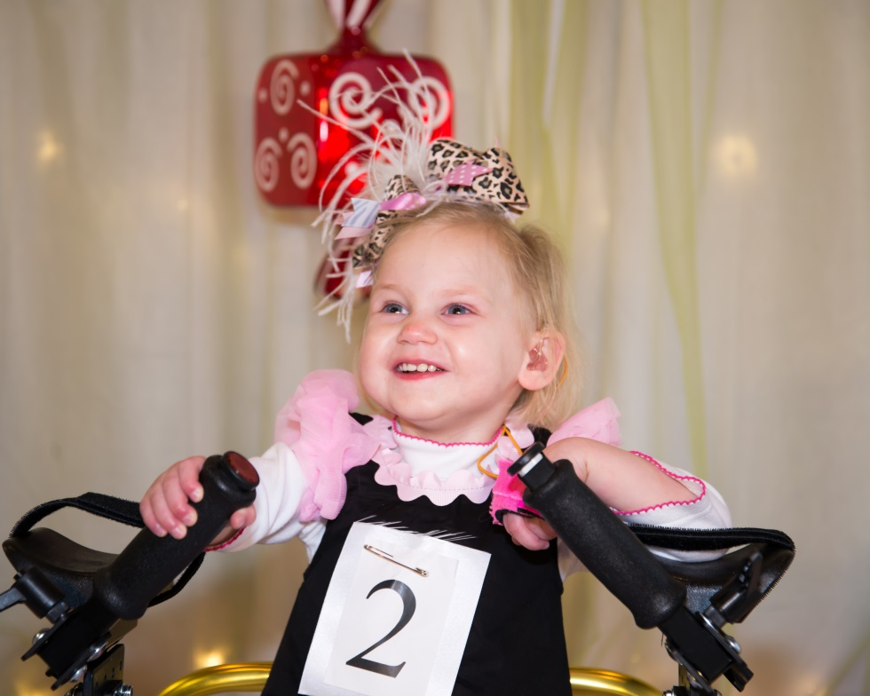
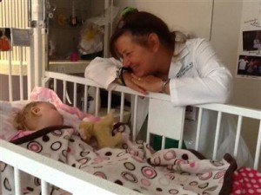
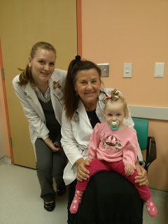
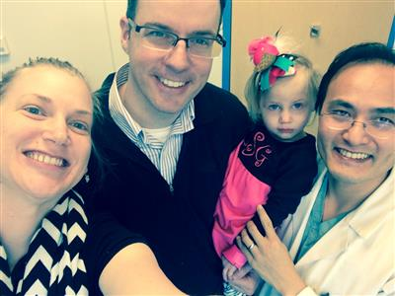
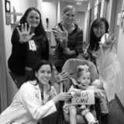
Parental Experience: Diagnostic Dilemma with congenital CMV Sandra Schiffli-Salerno
Department of Pediatrics Baylor College of Medicine and Texas Children’s Hospital, Houston, Texas
INTRODUCTION
[PICTURES]
Recent photos of Lillian!
This is the story of our brave daughter Lillian Grace Salerno and the long and difficult path we took to eventually learning that she was born with a Congenital CMV infection.
BACKGROUND
RESULTS / DISCUSSION
Lillian Grace was born on 12.28.2011 with no signs or symptoms of problems. She passed all of her newborn screens. Around six months of age she had microcephaly and was not meeting her developmental milestones so we consulted with a neurologist.
Shortly after she was diagnosed with polymicrogyria, intractable epilepsy, cerebral palsy, and hearing loss ….all which eventually led us to a diagnosis of CMV.
Although Lillian thrives today she has many permanent long term impairments due to CMV. She receives multiple therapy sessions (8) and Dr. visits (1-2) per week. Also, due to Lillian’s intractable epilepsy she underwent a radical brain operation called a hemispherectomy in August 2013.
I can’t help but wonder how much of this could have been avoided had we been educated about CMV, been tested for it during pregnancy, received treatment in utero, or even had we tested her for it at birth.
METHODS
METHODS
After learning our daughter had microcephaly and failed to meet her milestones by six months we were referred to neurology.
She had a brain MRI at eight months and we learned that the right side of her brain did not form properly, and she had a malformation called polymicrogyria. This discovery prompted a borage of genetic tests which revealed no anomalies.
During this time I also learned that my daughter had a profound hearing loss in her left ear. We also noticed little jerking movements that were diagnosed as seizures. I was so worried about WHAT could have possibly caused this and also – was this a progressive disorder that would slowly take the life away from my daughter?
After conducting my own research online I read about the connection between Polymicrogyria and CMV. I had Lillian tested around 10 months of age and she tested positive for a prior CMV infection.
This however could not confirm that our daughter had a congenital CMV infection. Working with Dr. Demmler I called the state of TX where Lillian’s newborn bloodspot had been stored and could be sent to the centers for disease control for further testing.
The newborn bloodspot tested positive for CMV at the CDC lab around the time Lillian was one. Finally we had our answer, but at that time she already had a profound hearing loss in one ear, even though she passed her newborn screen. Fortunately we had an answer but unfortunately it was a very stressful and painstaking year of searching, while our daughter was missing a valuable treatment window.
PROBLEMS / OBSTACLES
CONCLUSION
While pregnant I went to the doctor numerous times with a respiratory infection, fever, weight loss, and general fatigue. I was told I had bronchitis, no one ever suggested that I might have a CMV infection. Lack of education and awareness regarding CMV was my first obstacle.
The second obstacle I faced was the heart wrenching discovery of the many challenges my daughter faced ONE BY ONE…from the brain malformation, seizures, hearing loss, cerebral palsy …and not knowing WHAT had caused it.
In the future, newborn screening for congenital CMV would avoid the diagnostic dilemmas my family has faced as well as the uncertainty and delay in diagnosis and treatment!!
ACKNOWLEDGEMENTS
I would like to thank Dr. Demmler-Harrison and her expert team at Texas Children’s hospital for the wonderful care and love my daughter has received.

