Slide 1


GLOBAL RESPONSE TO CONGENITAL CYTOMEGALOVIRUS (CMV) AWARENESS THROUGH A PEDIATRIC HOSPITAL BLOG WEBSITE
Gail J. Harrison, M.D., Cara C. Lyons, Michael Reina, Holly McBride MPH,
Marily Flores, M.S., Cindy de los Santos, Jill Williams

Slide 2
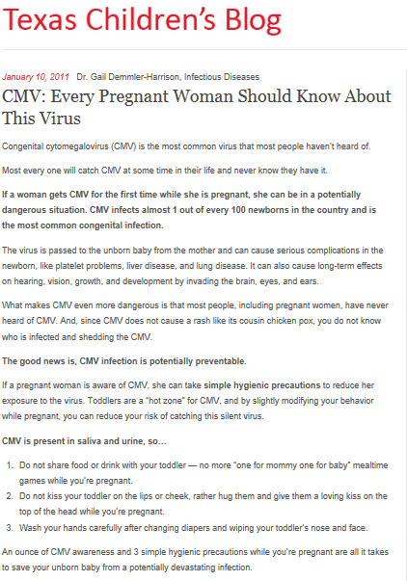
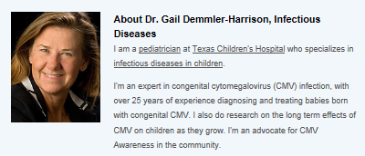

Slide 3
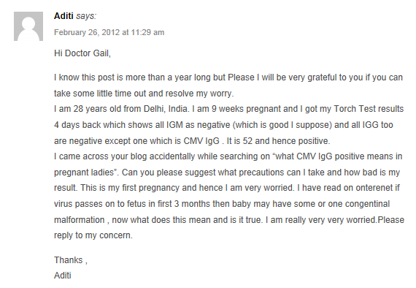
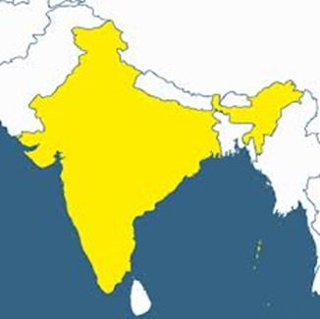
CMV Blog Post Comment from Aditi:
India

Slide 4
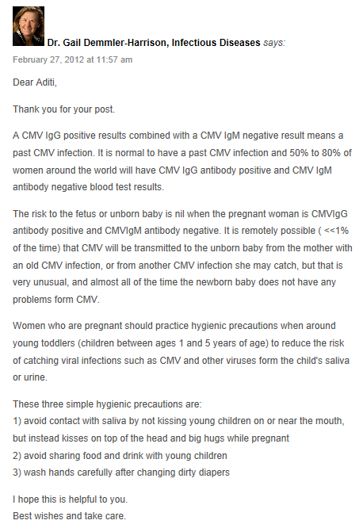
Dr. Demmler’s Response to Aditi’s Blog Post Comment:

Slide 5
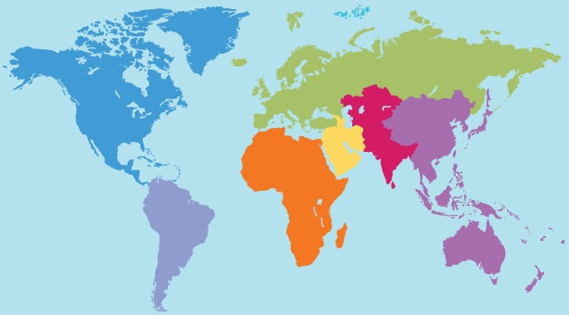
Countries Impacted by CMV Blog
Europe 83% (39 of 47)
Asia 98% (43 of 44)
North America & South America 69% (24 of 35)
Africa 39% (21 of 54)
Oceania 14% (2 of 14)
67% of the Worlds’ Countries Impacted by CMV Blog 129 of 194 countries; 6 of 7 Continents.

Slide 6
Blog views per continent
Unique page views totaled 26,559 of 32,294 total page views with an average time of 4:33 minutes on the blog page.

Slide 7
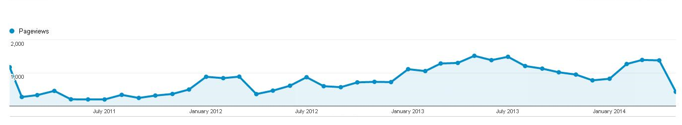
Monthly pageviews 2011-2014

Slide 8
Main source of blog views 2011-2014

Slide 9
Blog views per operating system and Device type
Operating system
Device used 2011-2014
2011-2012
2011-2014

Slide 10
Devices used over time to access CMV Blog

Slide 11
Popular Keywords
Top 5 Searched Keywords | Page views
Not set/provided | 18132
CMV pregnancy | 241
CMV and pregnancy | 209
How do I know I had CMV when pregnant | 190
Cytomegalovirus CMV IGG precaution during pregnancy | 112

Slide 12
Blog use worldwide
Life of Blog | 40 months
Avg time spent on blog | 4:33 minutes
Total Pageviews | 32294
Unique Pageviews | 26559
Internet Sources/landing pages | 224
Operating Systems | 19
Keywords | 3750
Cities | 2494
Countries | 129
As of May 9, 2014 the CMV TCH blog has a total of 506 responses and or comments.

Slide 13
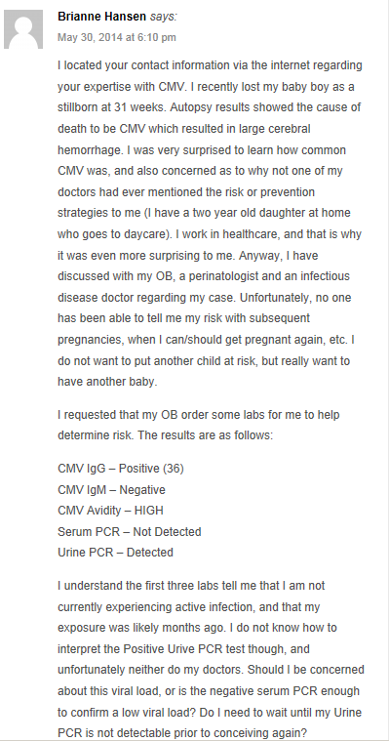
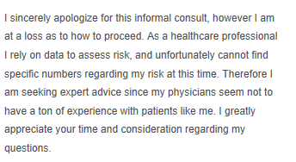
CMV Blog Post Comment from Brianne:
North
America

Slide 14
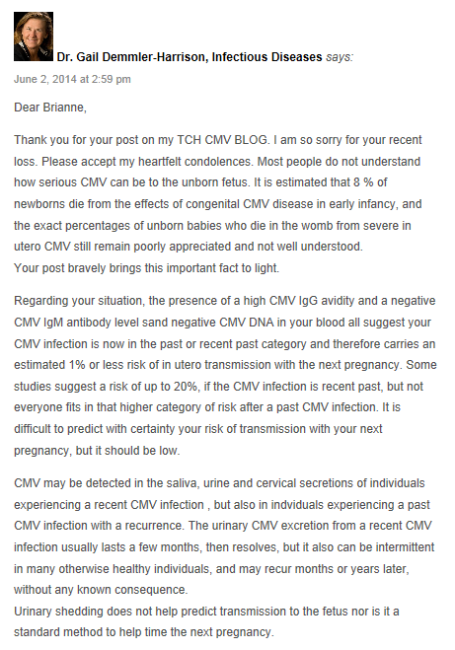
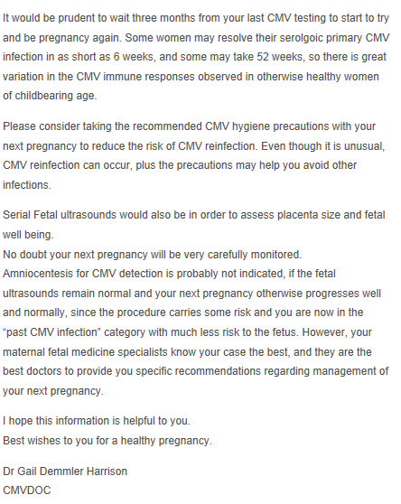
Dr. Demmler’s Response to Brianne’s Blog Post Comment:

Slide 15
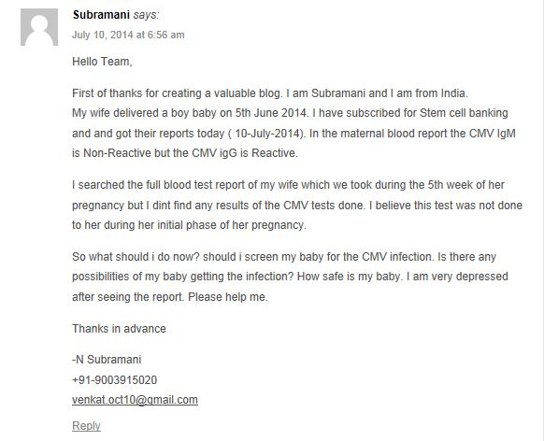

CMV Blog Post Comment from Subramani:
India

Slide 16
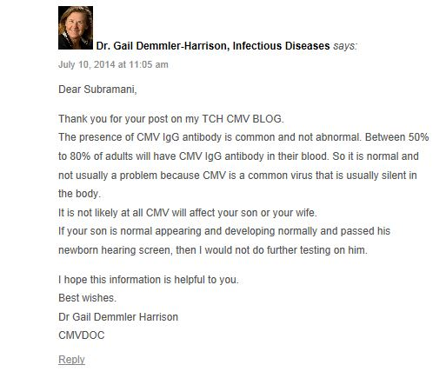
Dr. Demmler’s Response to Subramani’s Blog Post Comment:

Slide 17
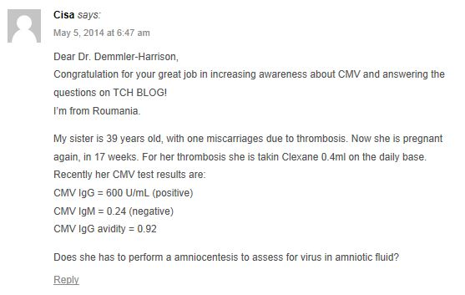
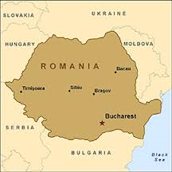
CMV Blog Post Comment from Cisa:

Slide 18
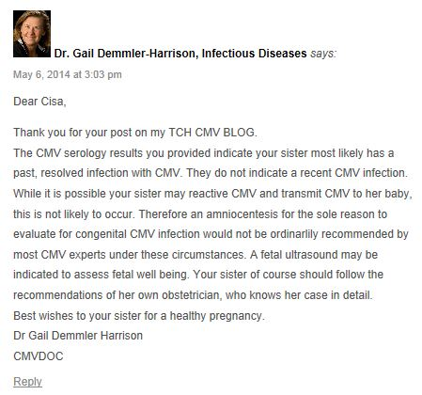
Dr. Demmler’s Response to Cisa’s Blog Post Comment:

Slide 19
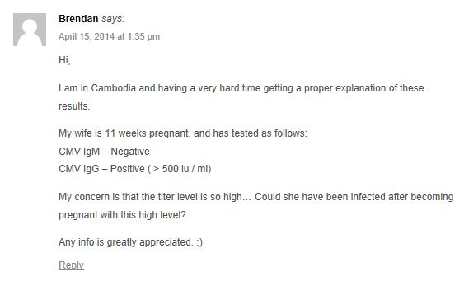
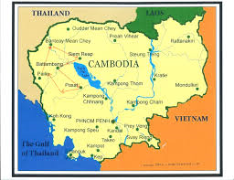
CMV Blog Post Comment from Brendan:

Slide 20
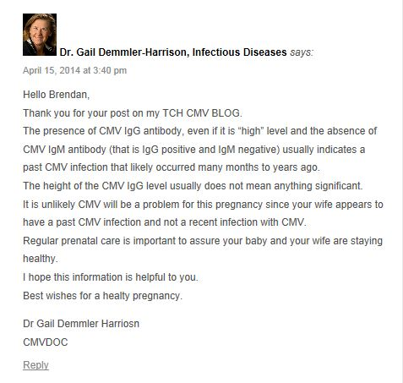
Dr. Demmler’s Response to Brendan’s Blog Post Comment:

Slide 21
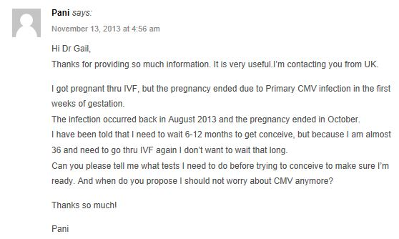
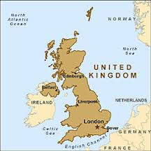
CMV Blog Post Comment from Pani:

Slide 22
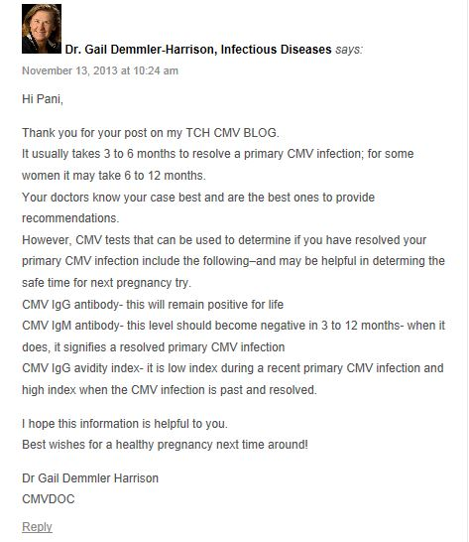
Dr. Demmler’s Response to Pani’s Blog Post Comment:

Slide 23
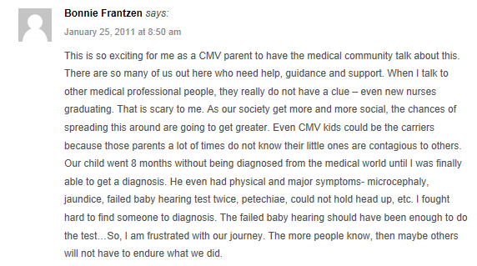
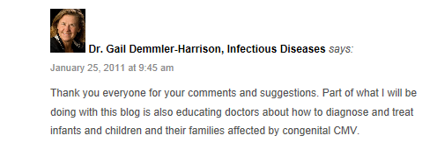
CMV Blog Post Comment from Bonnie:

Slide 24
GLOBAL RESPONSE TO CONGENITAL CYTOMEGALOVIRUS (CMV) AWARENESS THROUGH A PEDIATRIC HOSPITAL BLOG WEBSITE
You are talking…
Pani says: November 13, 2013 at 4:56 am
Hi Dr Gail,
Thanks for providing so much information. It is very useful.I’m contacting you from UK....
rin says: May 12, 2011 at 7:04 pm
I am so glad to find this site
Diana says: January 25, 2011 at 12:26 am
Great info and so straight forward. This is a great post to share with every woman in their child bearing years.
Keri says: January 24, 2011 at 6:38 pm
I wish I had known about this before my 3rd pregnancy. Having two perfectly healthy, normal pregnancies, I never thought I would have problems with my last. At my 20 week appointment, there was no heartbeat. My son, Michael, died between the 16th/17th week. The pathology report showed I had contracted CMV around that time. Apparently had never had it and it ultimately caused Michael his life. I have a toddler and a 7-year-old, certain that I picked the virus up from day care/school. WIsh I would have known about it before – so I could have been more careful.
Kasia says: March 12, 2012 at 1:16 pm
Hello
I’ m from Poland and we dont talk much about this virus in my country. I’m very concern about this problem....
pankaj says: January 25, 2011 at 4:18 pm
Thanks Dr Gail
I will post this on my facebook
Ã¼bersetzung englisch deutsch says: July 26, 2013 at 9:28 am
Hi colleagues, its great post about teachingand fully explained, keep it up all the
time.
Lisa Saunders says: January 11, 2011 at 5:26 am
Thanks so much for doing what you can to make women aware of CMV. I really hope someday that OB/GYNs will make a CMV prevention message a standard practice of care.
rakesh marpuri says: June 28, 2014 at 1:01 pm
Dear Doctor,
This is Rakesh from India. First of all appreciate your effort in creating awareness regarding the CMV virus....
Dr. Stanley A. Plotkin says: January 25, 2011 at 2:37 pm
Dear Gail-
I see that you are party to this blog created for parents of CMV damaged children. That’s great, and I just wanted to say that it might be useful if the parents pushed NIH to support vaccine studies. Also, IOM is doing a new review of vaccine priorities and we don’t want CMV to fall from first priority.
Thanks and regards,
Stanley A Plotkin, MD
Emiritus Professor of Pediatrics, University of Pennsylvania
Vaxconsult
Lynn Maloney says: May 7, 2013 at 6:49 pm
Hello Dr. Gail,
Your blog continues to be a wealth of information for people dealing with CMV ....
Alen says: September 8, 2013 at 1:59 pm
Respected Dr Gail,
I am very happy to see your comments and help you provide to those are in need of your information....
We are Listening…

